Slide 1
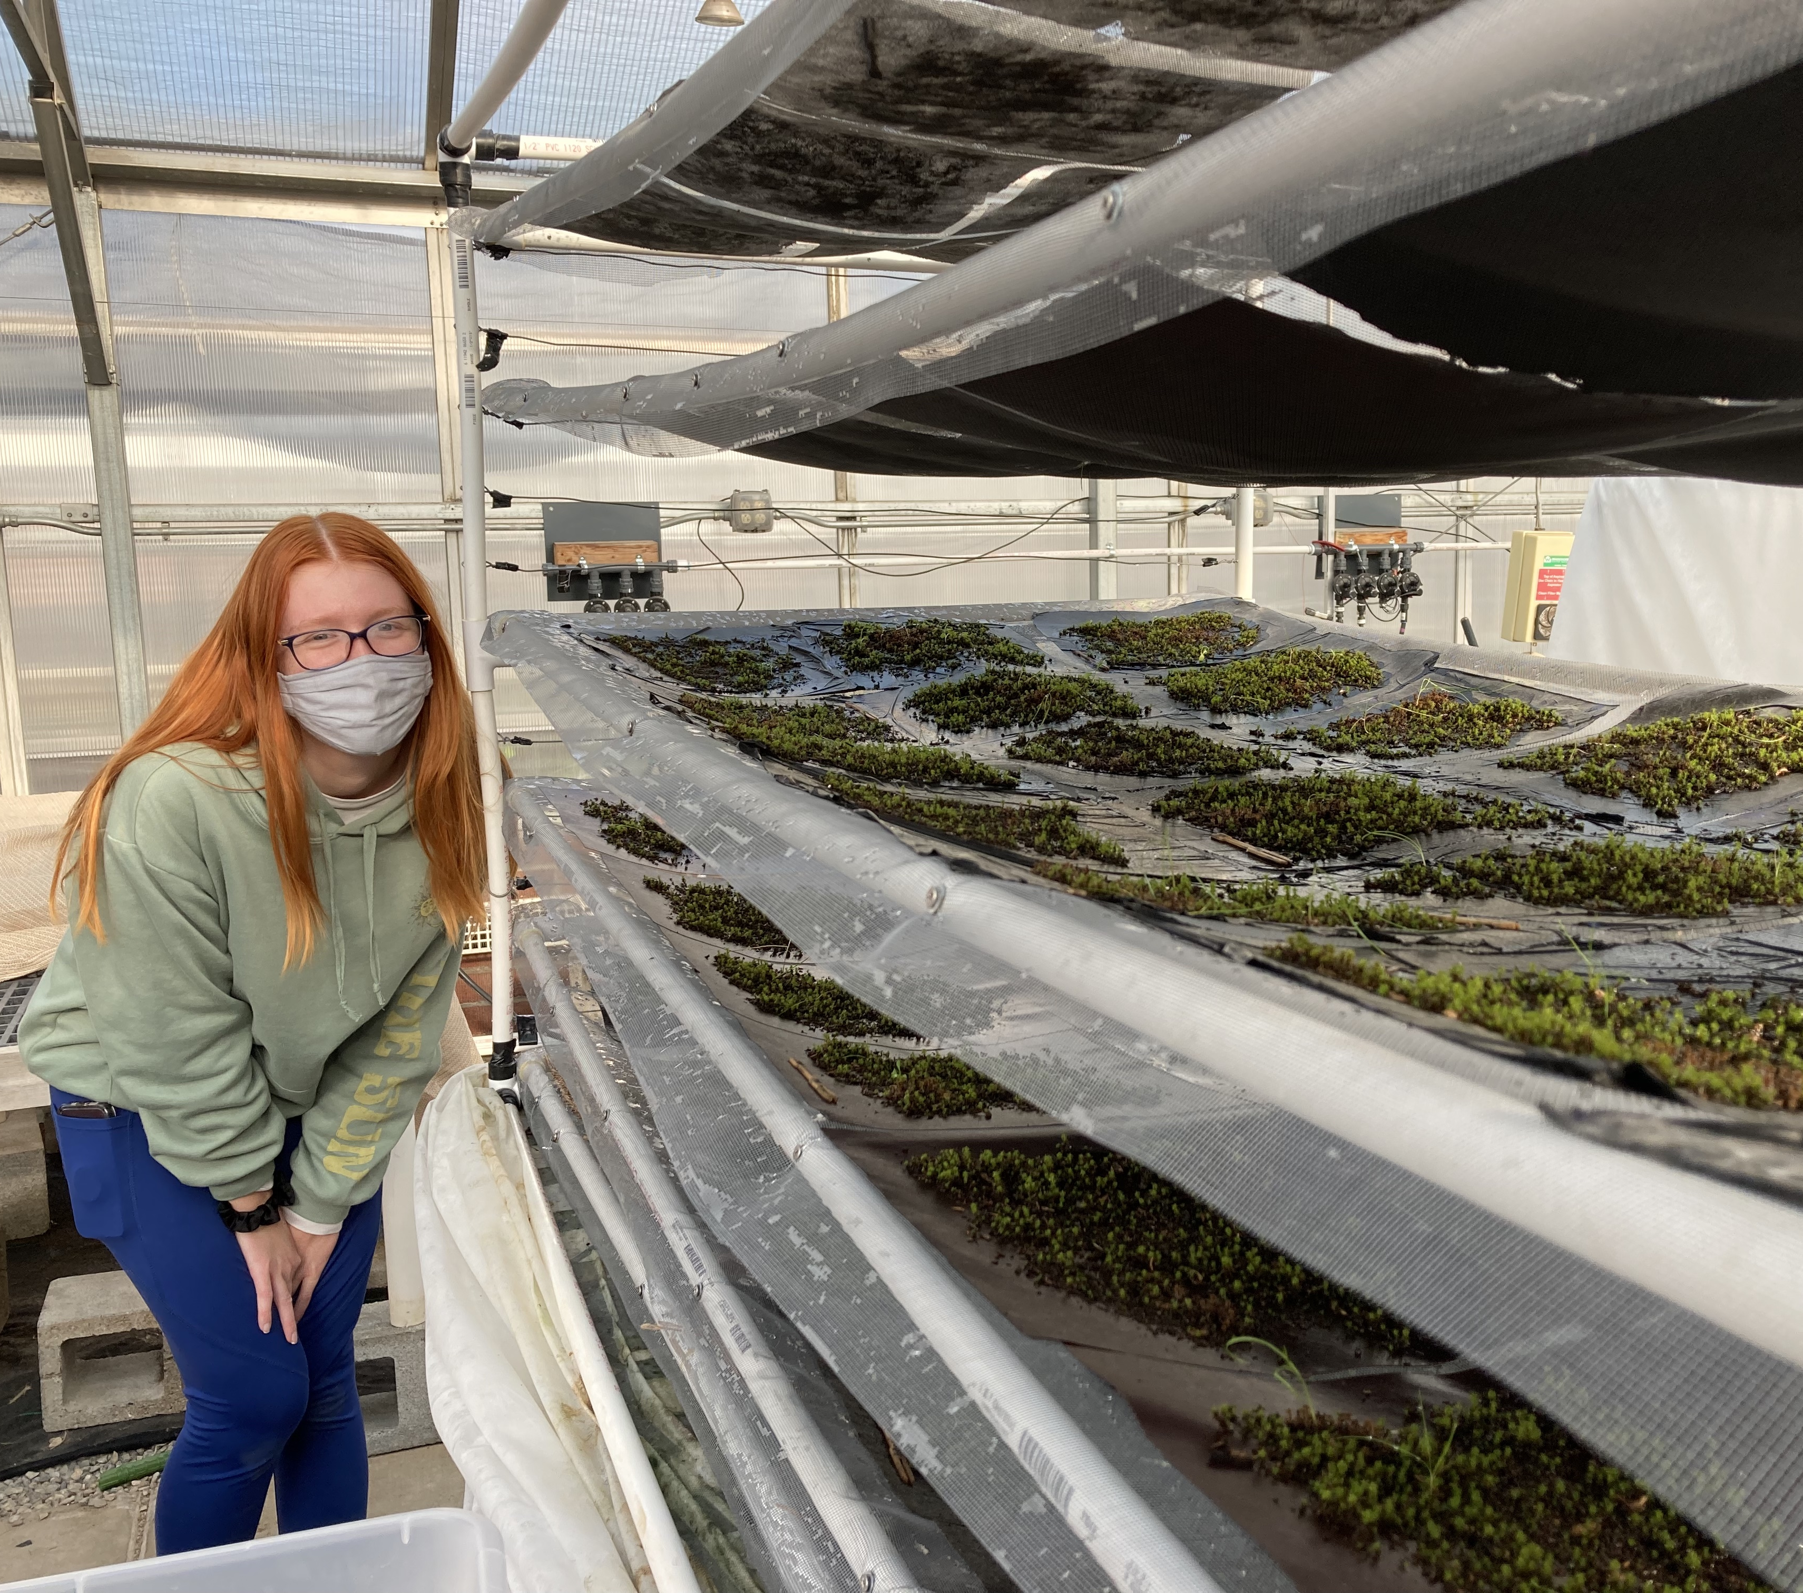



Moss Pellets: Exploring New Regenerative Methods in Degraded Grassland Ecosystems
Nelly McCuistion
Arizona Space Grant Consortium
April 2022
Mentors
Jasmine Anenberg, PhD Student
Northern Arizona University
Dr. Anita Antoninka, Assistant Research Professor
Northern Arizona University

Slide 2
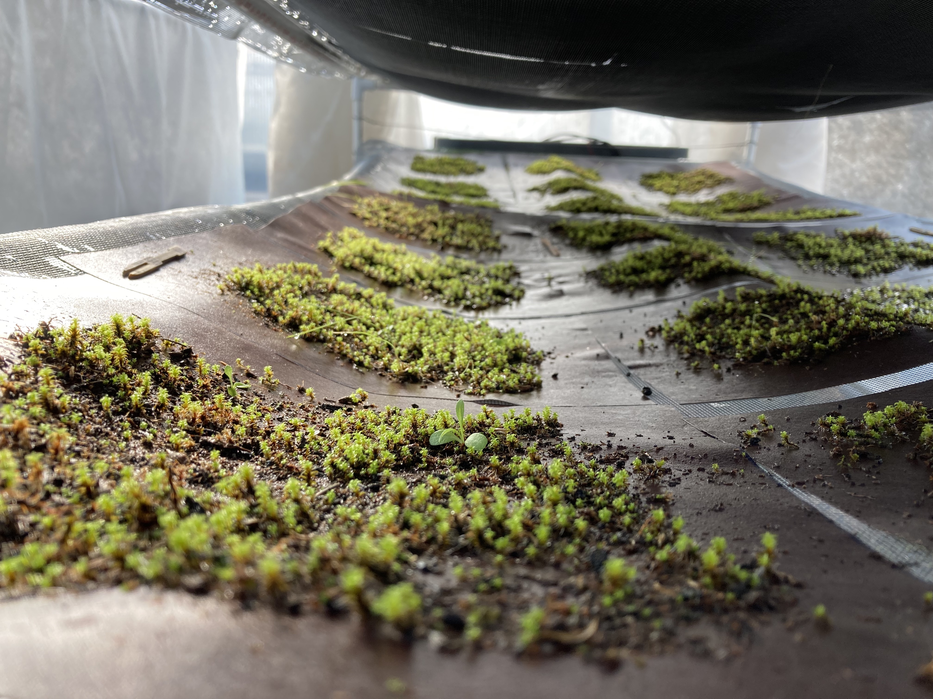
Background: Why moss?
Moss retains water
Soil stabilization
Seed germination
Grassland restoration
Notes:
Mosses can hold up to 1000% times their weight in water
-thus, reduce water runoff
-good for restoring situations like burn scars
-moss buffers soil temperature to allow for successful seed germination

Slide 3
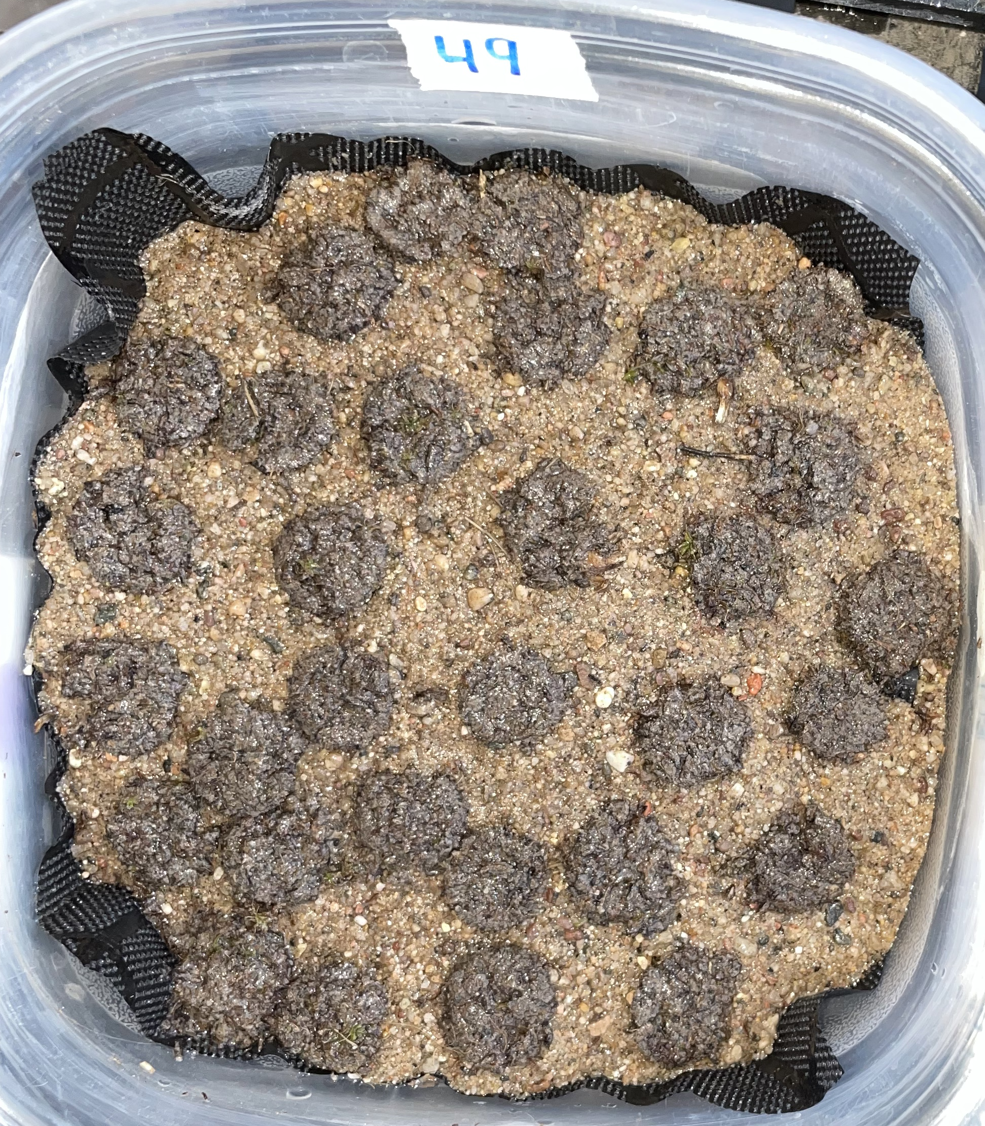
Background: Why pellets?
Easy storage and transport
Low maintenance
Even spread of coverage
Cost efficient production

Slide 4
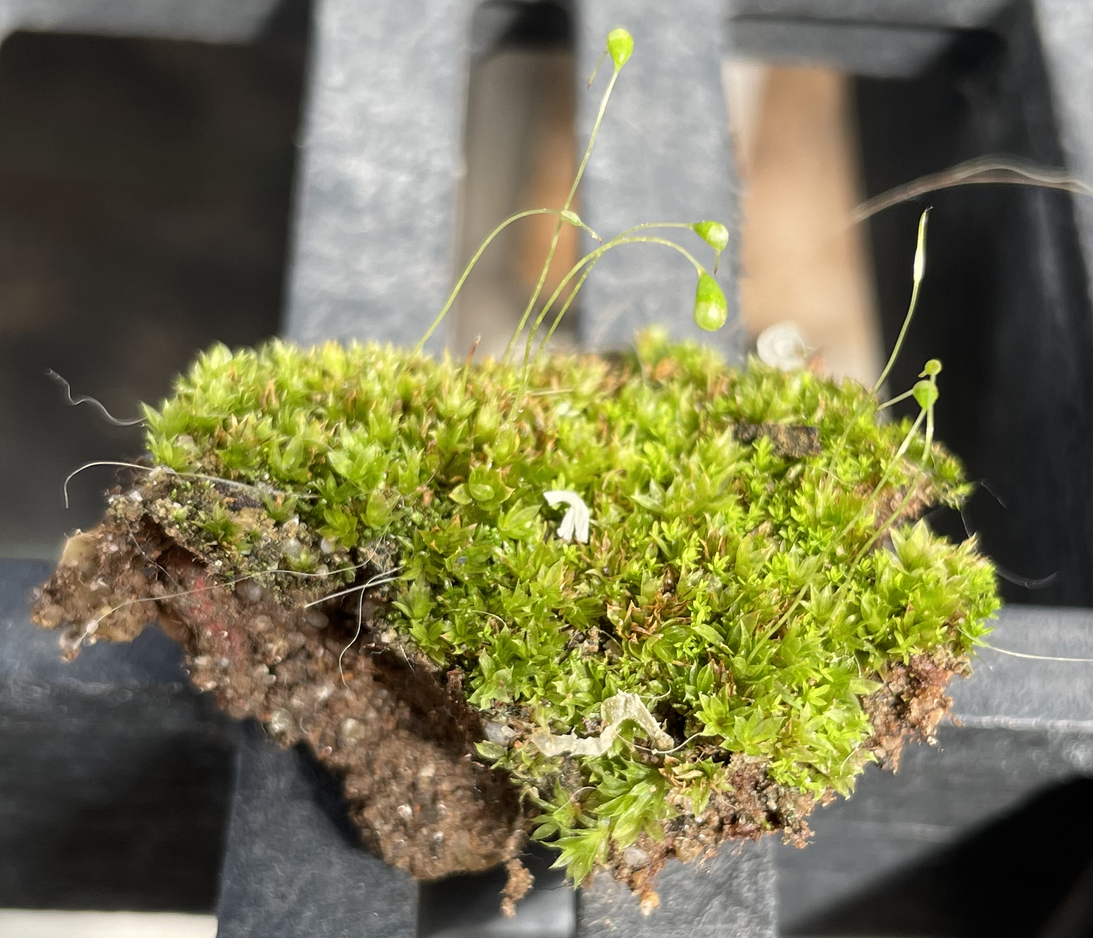
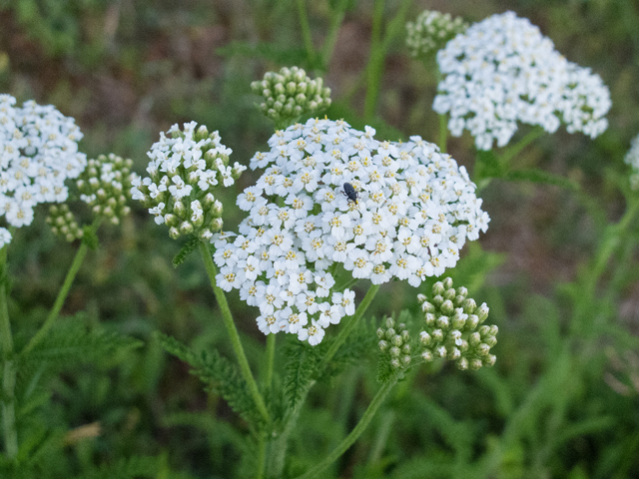
Objectives of the project
Observe interactions between pellet material, yarrow (Achillea millefolium) and moss (Syntrichia ruralis)
Notes:
Mention challenges in the lab

Slide 5
Objectives of the project
Observe interactions between pellet material, yarrow (Achillea millefolium) and moss (Syntrichia ruralis)
Observe pellet breakdown
Develop moss/seed pellet recipes for restoration
Notes:
Mention challenges in the lab

Slide 6
Introduction
Questions:
a. Do moss pellets encourage moss/seed germination?
Hypothesis: Pellet material may deter pests and insects from eating seeds and moss material, as it contains diatomaceous earth, a common garden ingredient. Pellets may also protect mosses and seeds from getting blown away or otherwise disturbed.
b. Do mosses and seeds form a positively correlated growth dynamic?
Hypothesis: Moss may encourage seed germination by retaining heat/moisture in the soil, extending the time window that seeds are able to germinate. Seeds may facilitate moss pellet breakdown by germinating and breaking open the pellets more.
Notes:
Add a more graphic representation

Slide 7
Methods
Monitoring once a week in NAU’s greenhouse
64 units in plastic containers
Irrigated three times a day, every day, using the “Bryotron” system
Pellet breakage rating system 0-3
25-point intercept to count vegetation cover
4 different pellet units and 4 different control units
Notes:
Cite Bryotron term from Doherty paper?

Slide 8
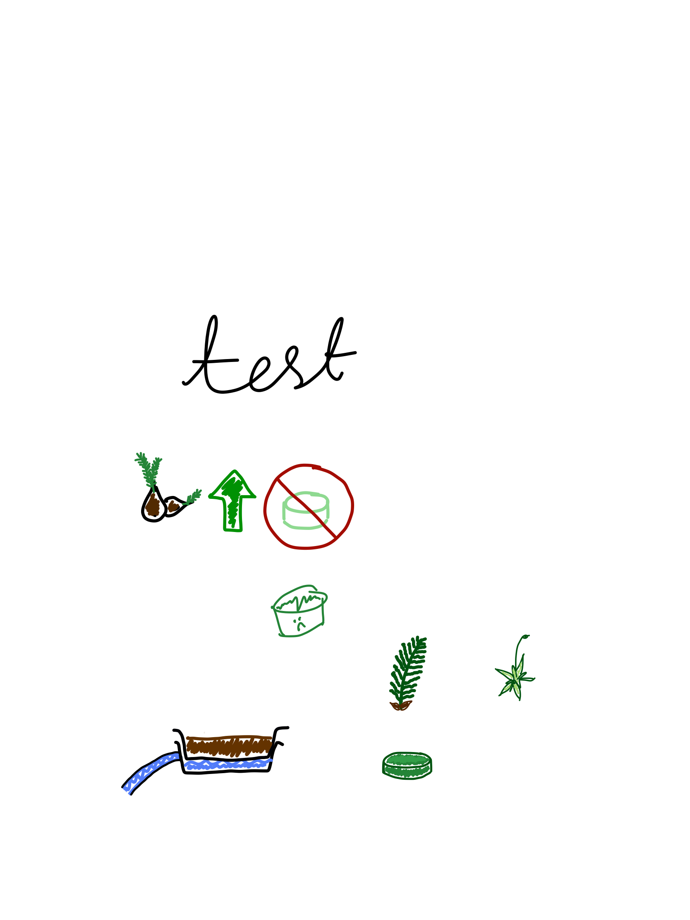
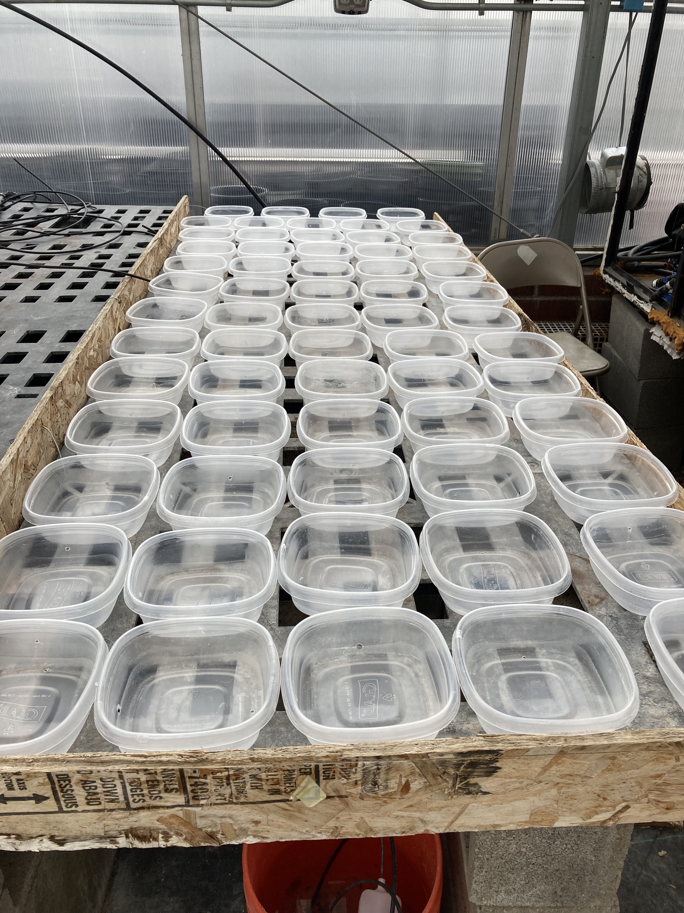
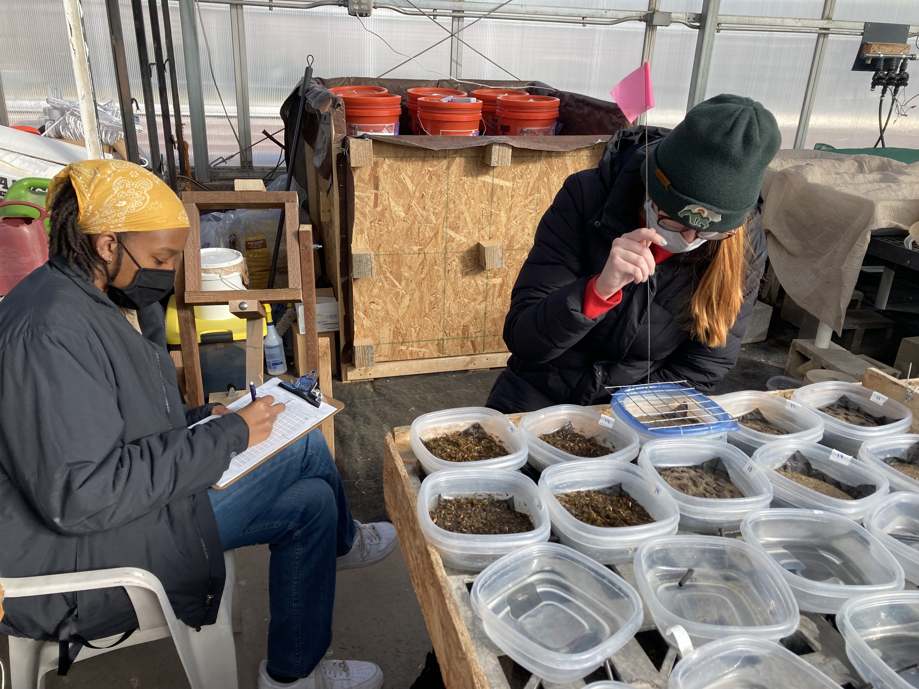
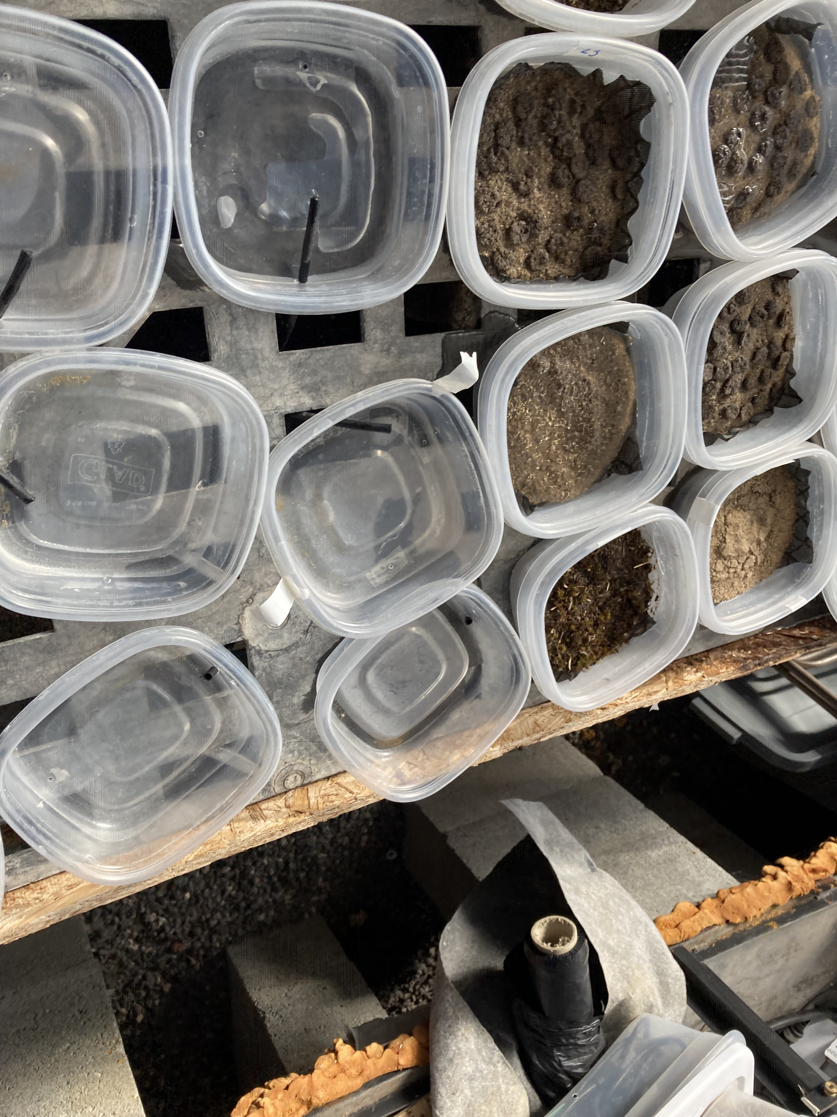

Slide 9
Results
Germination with vs without pellet material
Yarrow may compete against moss
Pellet breakdown, recipe success

Slide 10
VS.
With
pellet material
Without pellet material

Slide 11
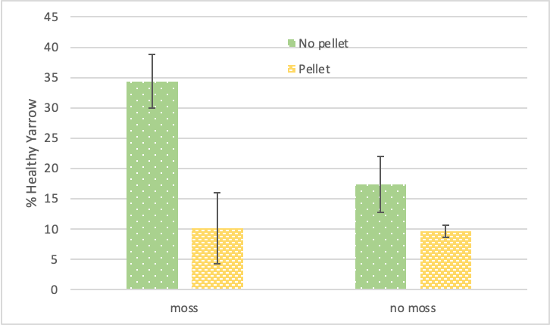
Seeds (yarrow) vs pellet and moss

Slide 12
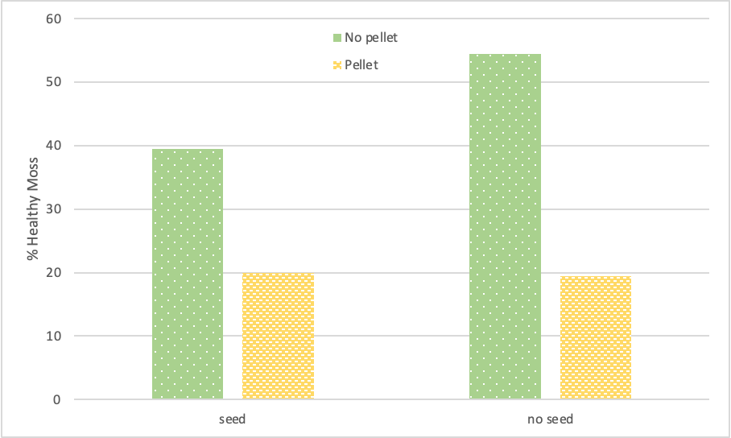
Moss vs seeds (yarrow) and pellets

Slide 13
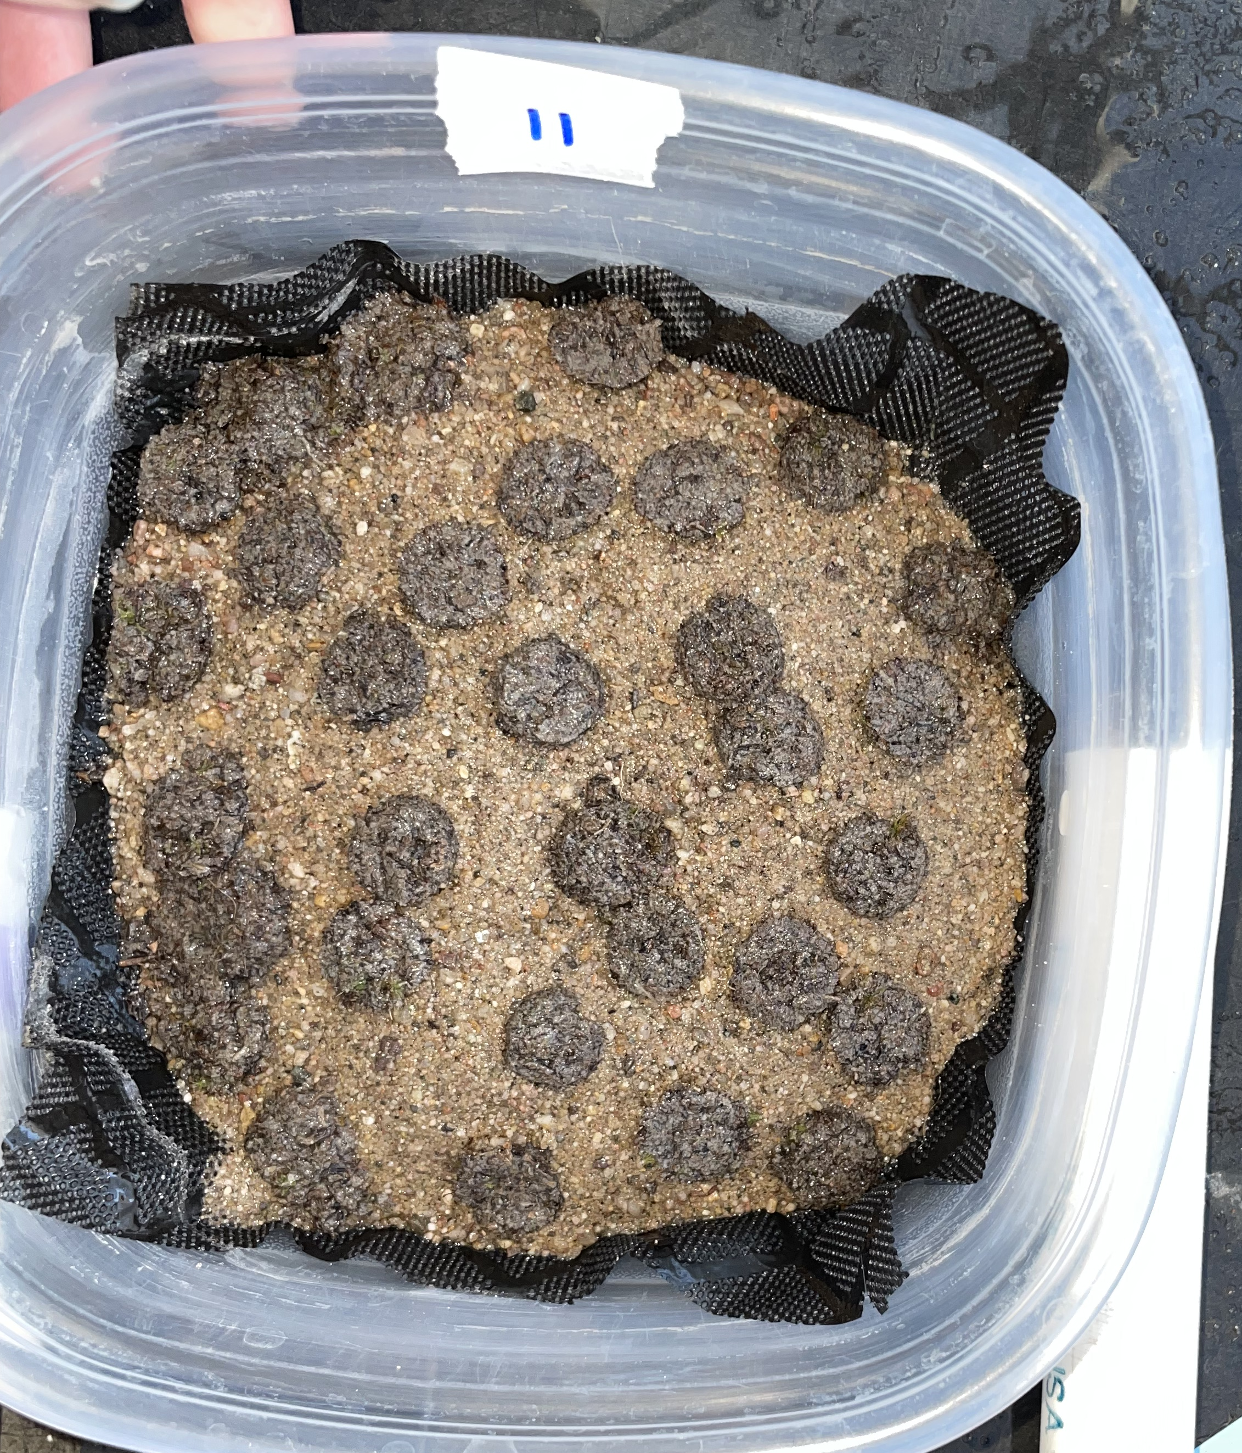
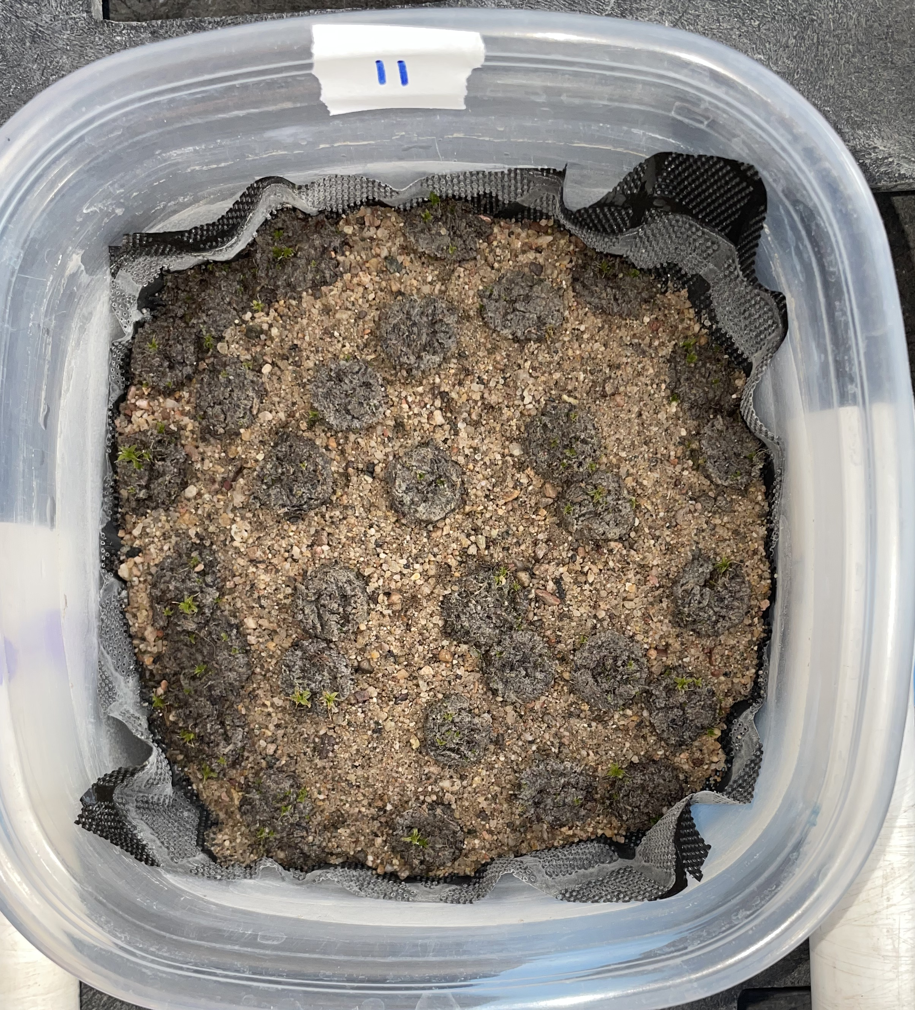
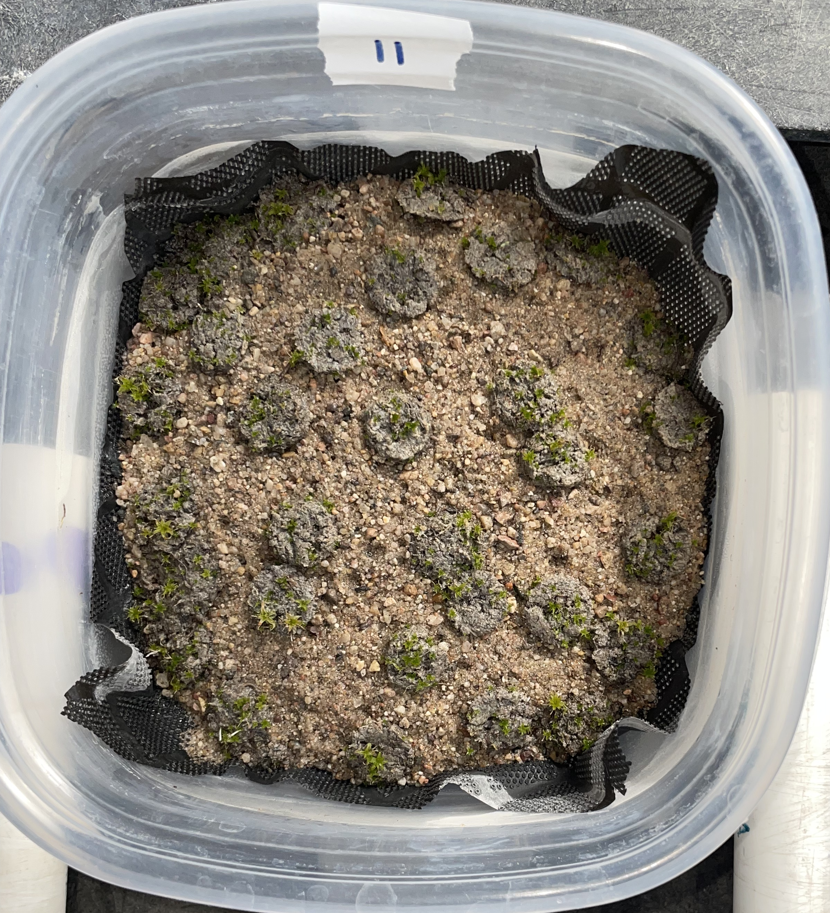
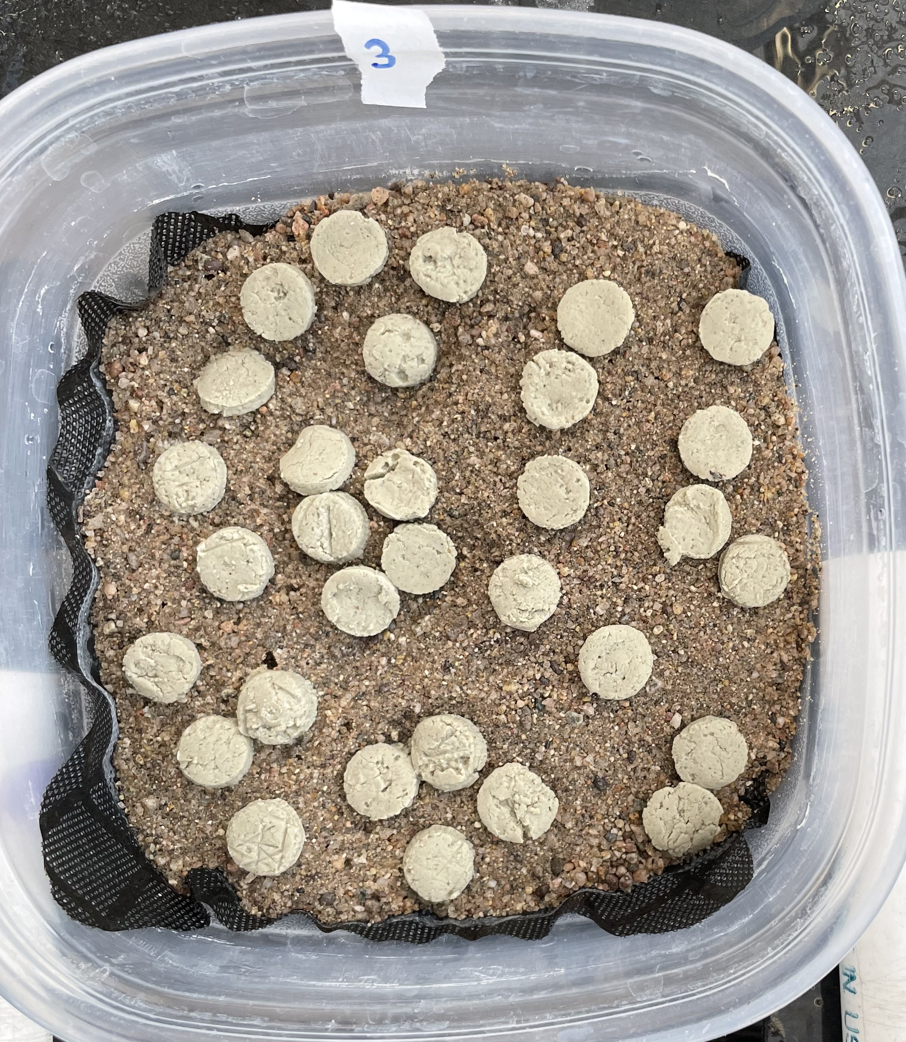
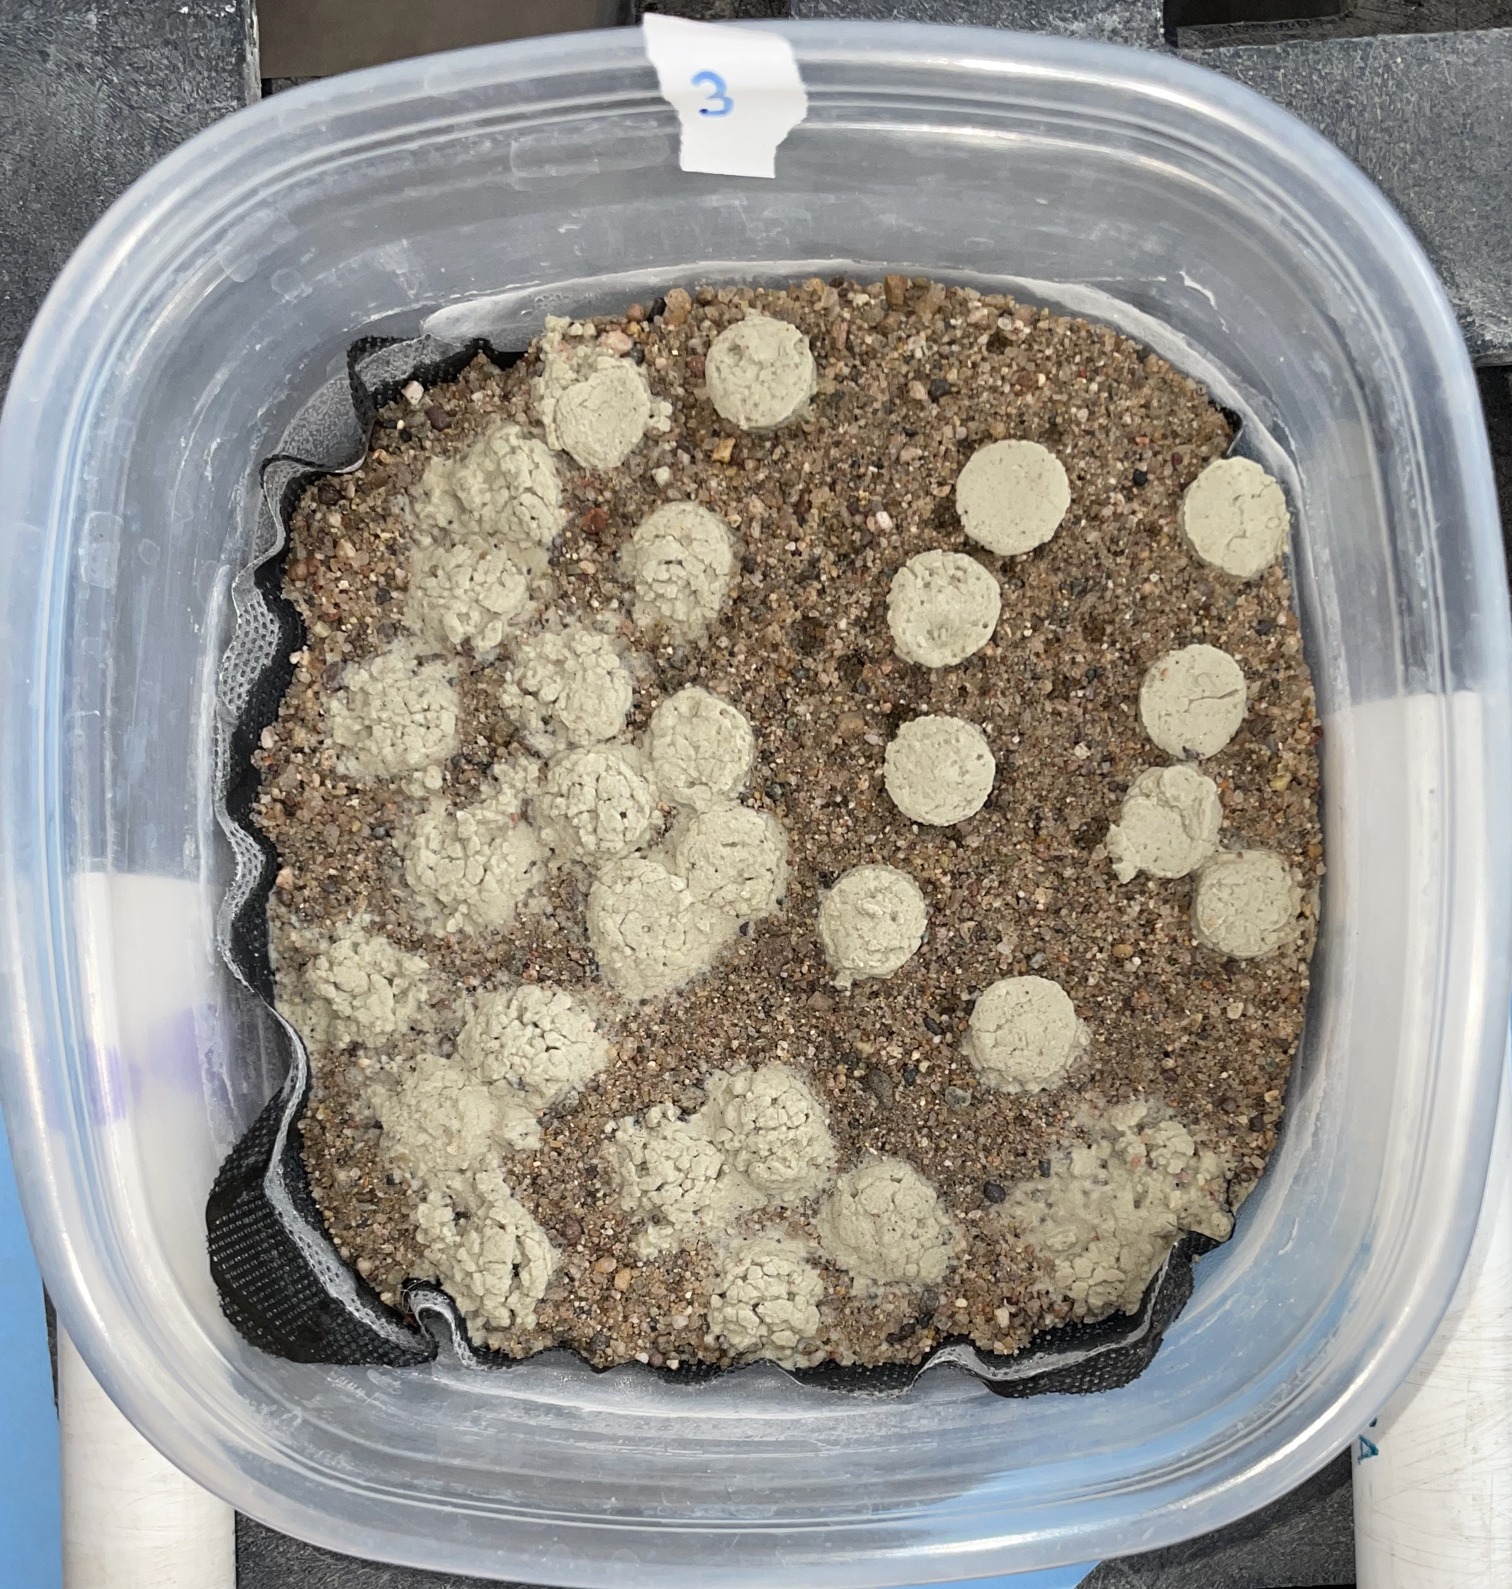
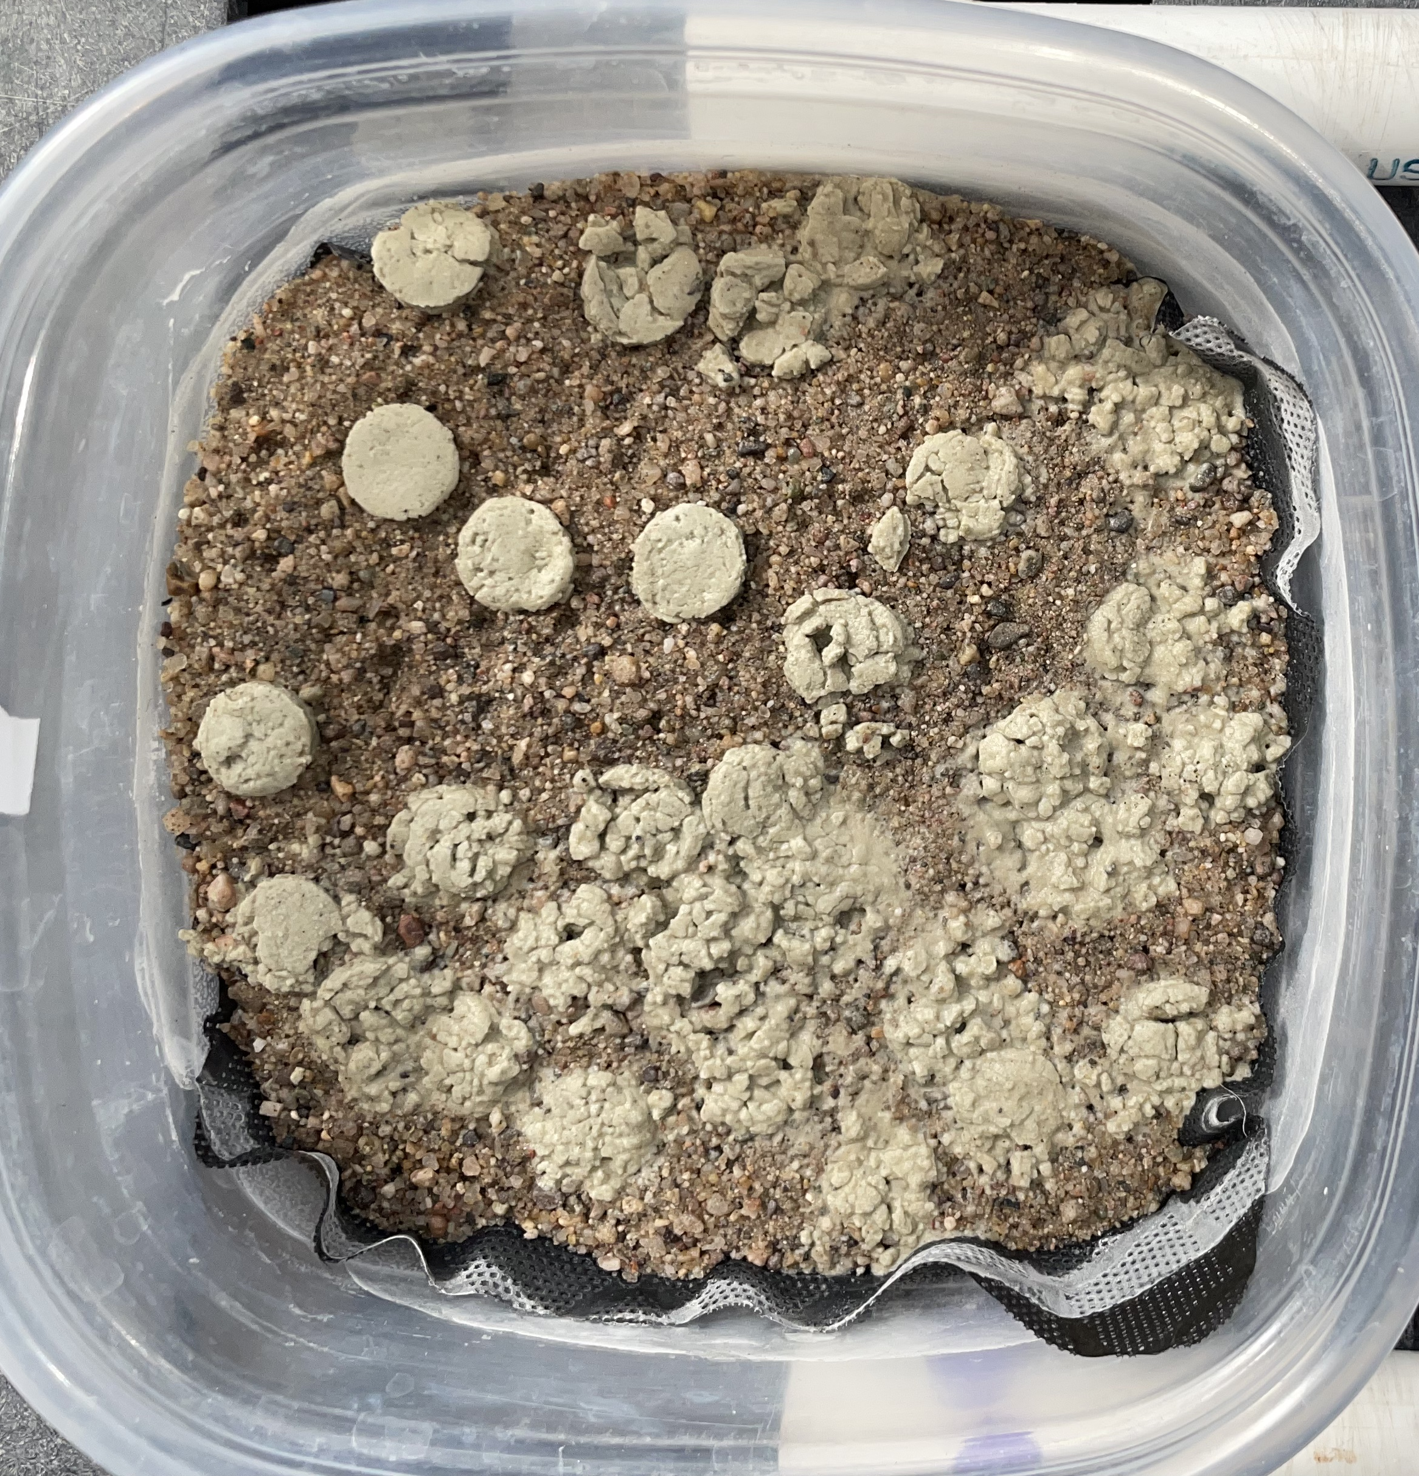
1
3
5
Moss pellet breakdown from week 1-5

Slide 14
Future implications
Field testing required
Need for effective restoration techniques
Gateway into testing similar restoration methods
Notes:
-restoration is always in demand
-in the future, it is important to focus on both effective restoration strategies, as well as accessibility to distribute
-in the future, must focus on both resto

Slide 15
Acknowledgements
NAU/NASA Space Grant
MPG Ranch
Jasmine Anenberg
Dr. Anita Antoninka
Adair Patterson
Dr. Nancy Johnson
Ivory Bacy
Michael Sloan
Dr. Matthew Bowker
Dr. Henry Grover

Slide 16
Thank you!

